Slide 1


trainity
OPERATION ANALYTICS INVESTIGATING METRIC SPIKE
AND
SALMAN BAREESH

Slide 2



PROJECT DESCRIPTION
The project involves performing Operational Analytics to analyze a company's end-to-end operations.
As the Lead Data Analyst, the goal is to investigate metric spikes within key performance indicators.
This includes understanding and explaining sudden changes in metrics, such as user engagement or sales, to derive valuable insights for different departments.

Slide 3


APPROACH
An approach of extracting entire required information from the given database using SQL queries was adopted.
This approach was executed using MySQL software.
Above approach resulted in direct insights on the questions asked without discomfort.

Slide 4

TECH-STACK USED
MySQL was used to run SQL queries
The reason I chose this language is because I have prior experience from my college

Slide 5
CASE1 : JOB DATA ANALYSIS
Number of jobs reviewed : Number of jobs reviewed over time
Throughput : It is the no. of events happening per second.
Percentage share of each language : Share of each language for different contents.
Duplicate rows : Rows that have the same value present in them.

Slide 6
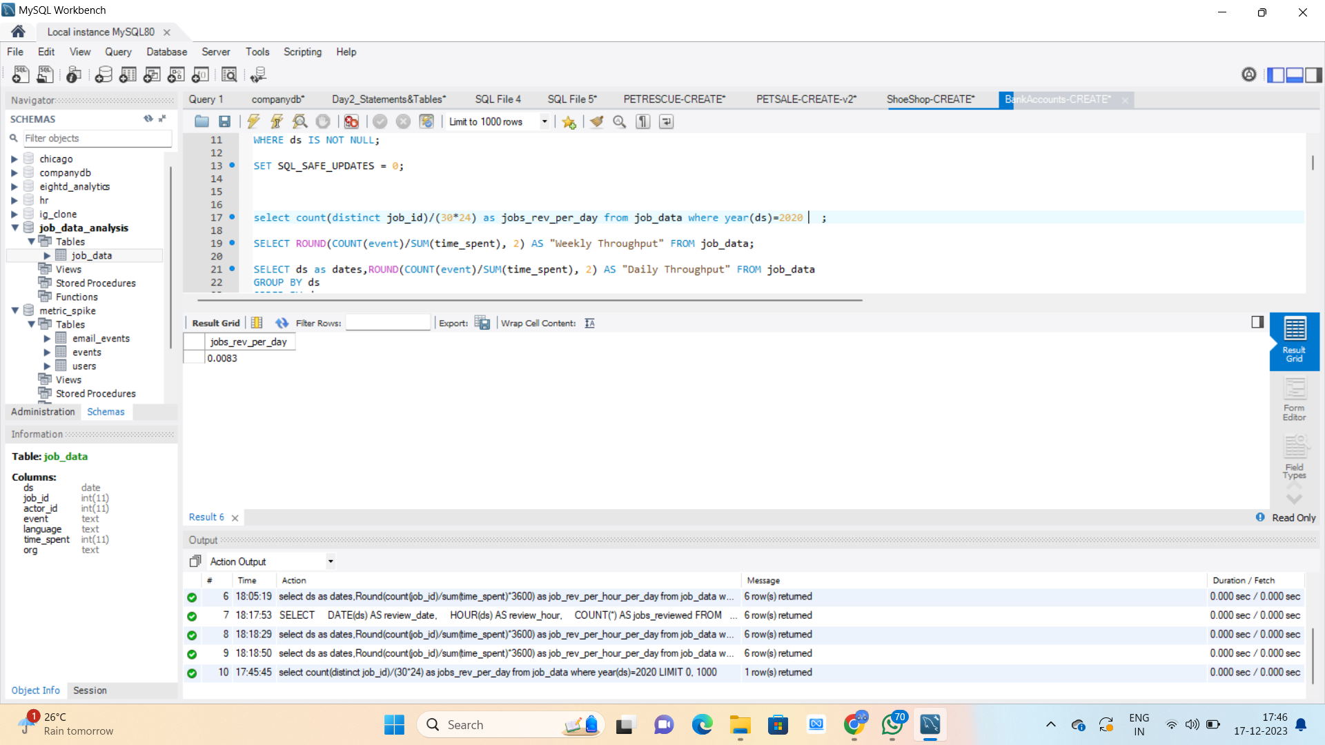
A. JOBS REVIEWED OVER TIME
Less than 0.01 jobs were reviewed each hour of the day throughout the month of November.
Syntax
select count(distinct job_id)/(30*24) as jobs_rev_per_day from job_data where year(ds)=2020 ;

Slide 7
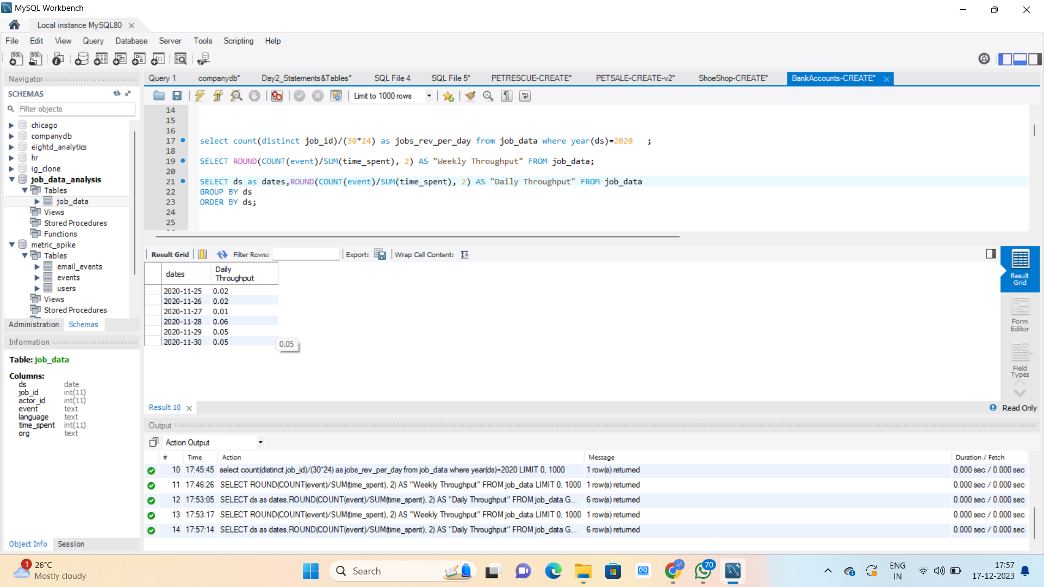
B. THROUGHPUT ANALYSIS
Using a 7-day rolling average for throughput can be helpful in understanding trends over time, as it provides a longer-term perspective compared to a daily metric. This can help to smooth out any short-term fluctuations in the data and provide a clearer picture of the overall trend.
Syntax
select ds as dates,round(count(event)/sum(time_spent), 2) as "Daily Throughput" from job_data group by ds order by ds;

Slide 8
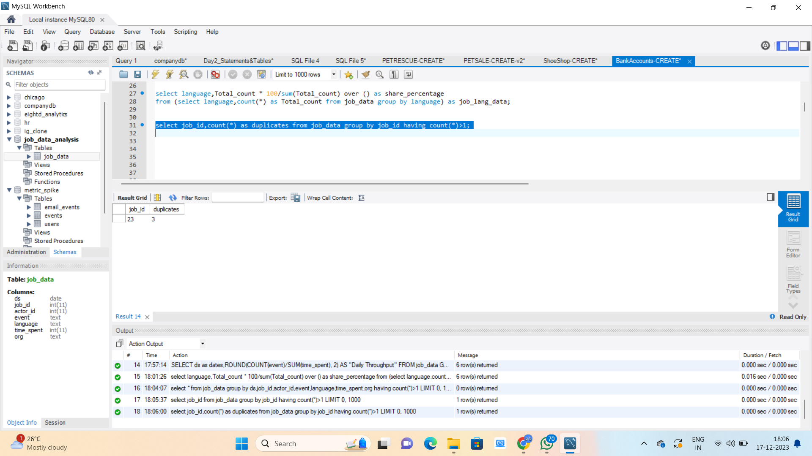
D. DUPLICATE ROWS DETECTION
The output showed two records as there were two duplicate job id in the dataset
Syntax
select job_id,count(*) as duplicates from job_data group by job_id having count(*)>1;

Slide 9
CASE2 : INVESTIGATING METRIC SPIKE
User Engagement: To measure the activeness of a user. Measuring if the user finds quality in a product/service.
User Growth : Number of users growing over time for a product.
Weekly Retention: Users getting retained weekly after signing-up for a product.
Weekly Engagement: To measure the activeness of a user. Measuring if the user finds quality in a product/service weekly.
Email Engagement: Users engaging with the email service.

Slide 10
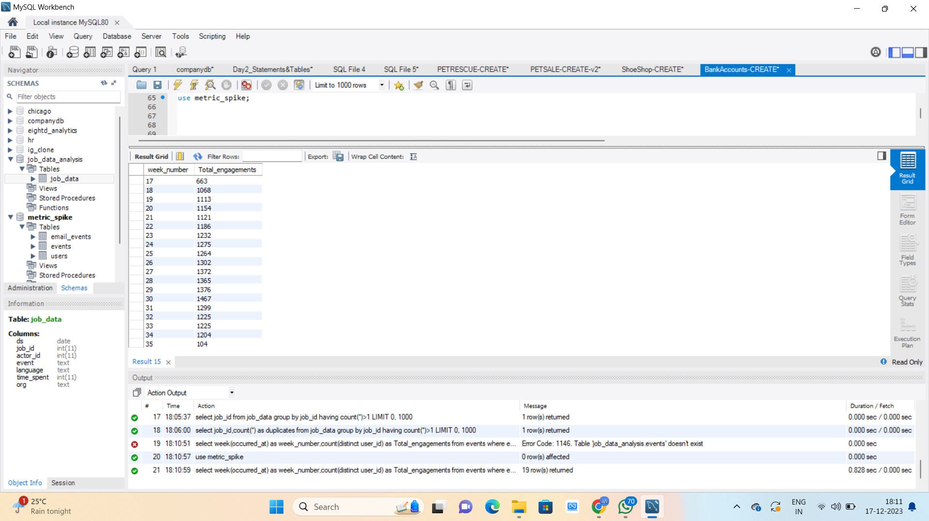
A. WEEKLY USER ENGAGEMENT
Week 31 posted the highest user engagement and week 18 posted the minimum user engagement
Syntax
select week(occurred_at) as week_number,count(distinct user_id) as Total_engagements from events where event_type="engagement" group by week_number;

Slide 11
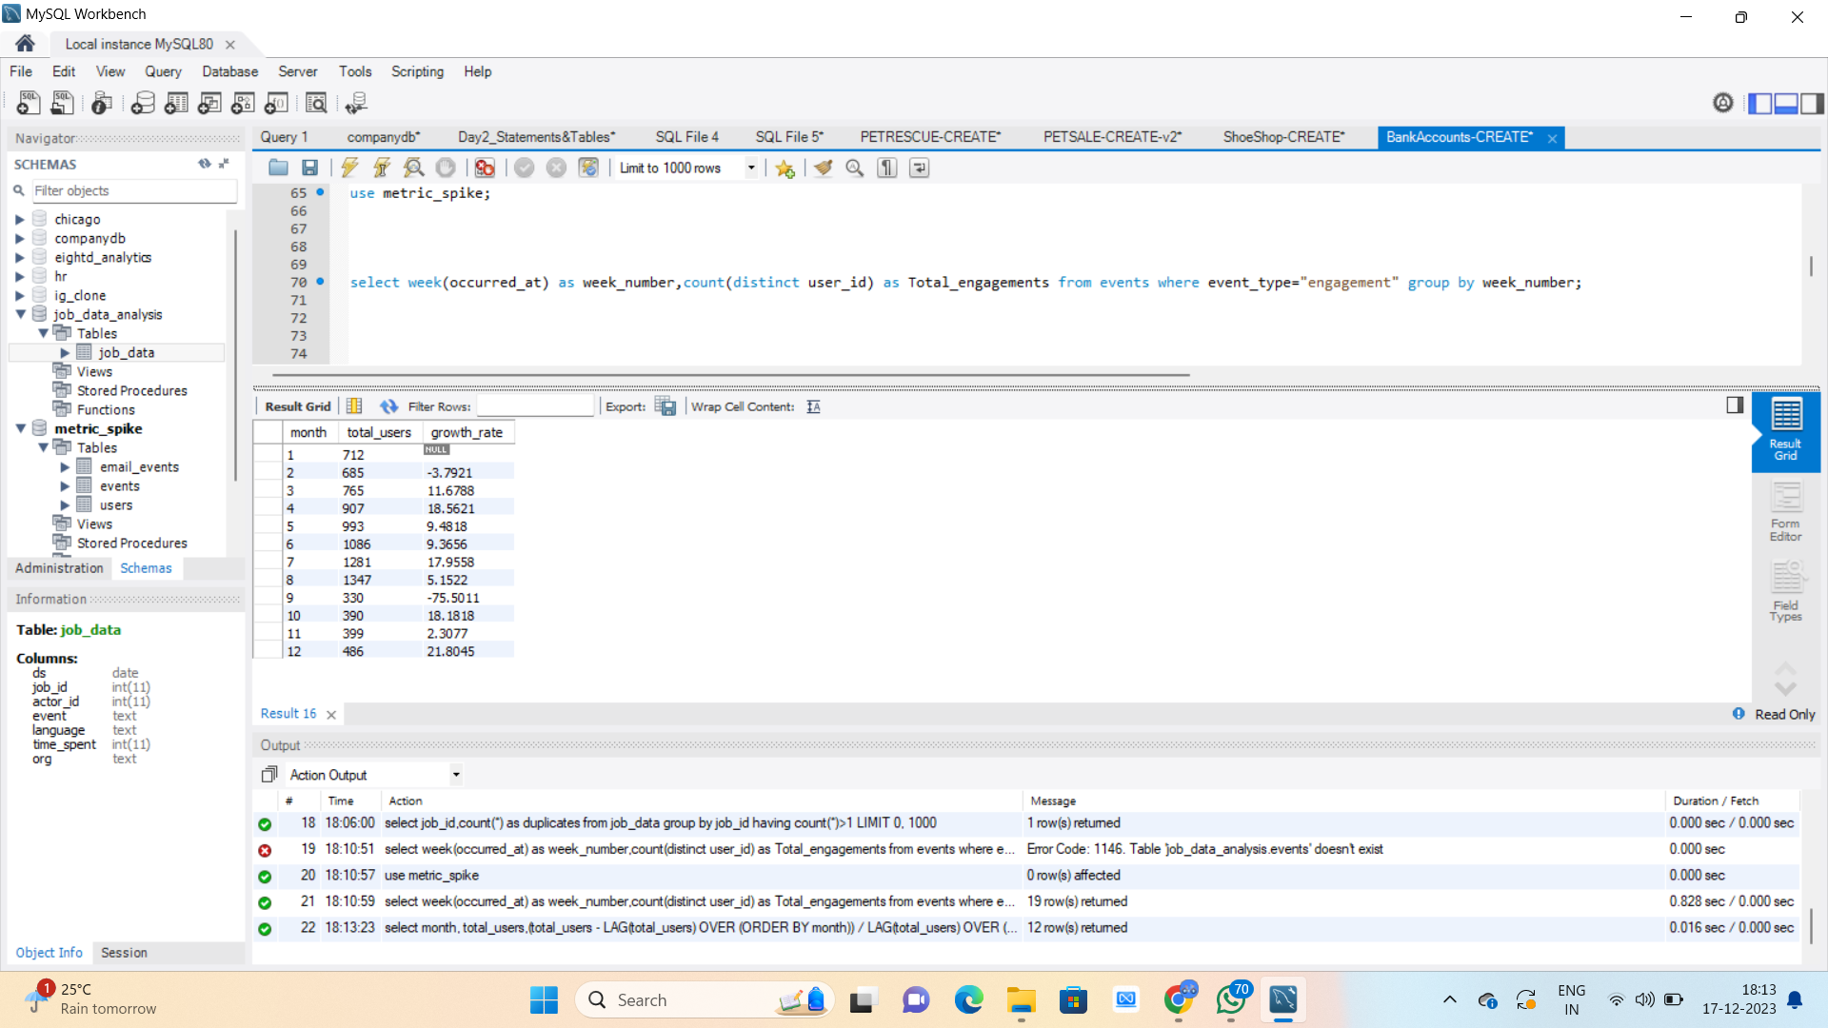
B. USER GROWTH ANALYSIS
From November to December the growth rate is 21%. Whereas from September to October growth rate is -75%
Syntax
select month, total_users,(total_users - LAG(total_users) OVER (ORDER BY month)) / LAG(total_users) OVER (ORDER BY month) * 100 AS growth_rate from (select month(created_at) as month,count(user_id) as total_users from users group by month) as user_growth ;

Slide 12
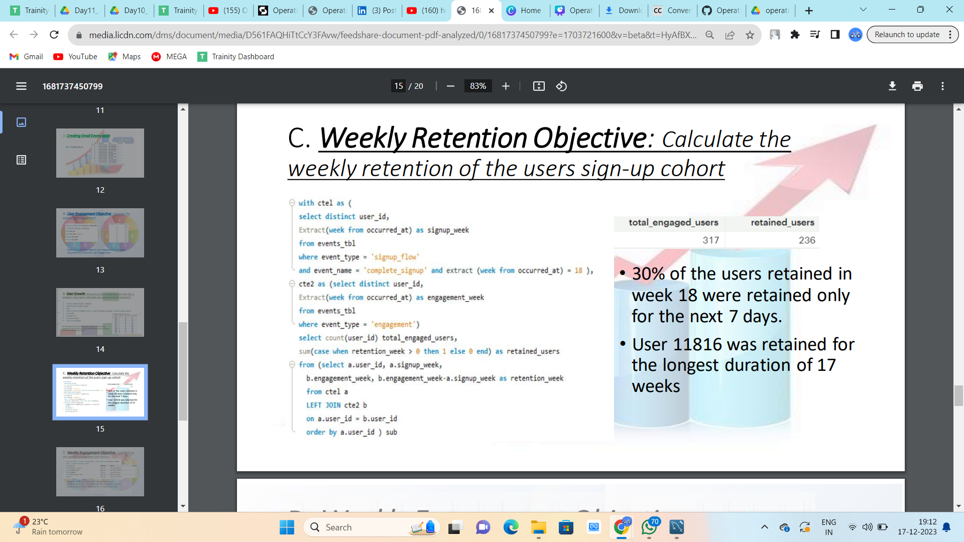
C.WEEKLY RETENTION ANALYSIS
30% of the users retained in week 18 were retained only for the next 7 days. User 11816 was retained for the longest duration of 17 weeks

Slide 13
C.WEEKLY RETENTION ANALYSIS
Syntax
select
count( user_id) as engaged_users,
sum(case when retention_week > 0 then 1 else 0 end) as retained_users
from (
select a.user_id, a.sign_up_week,b.engagement_week,b.engagement_week - a.sign_up_week as retention_week
from (
select distinct user_id,week(occurred_at) as sign_up_week from events where event_type = 'signup_flow'
and event_name = 'complete_signup' and week(occurred_at) = 18
) a
left join
(
select distinct user_id, week(occurred_at) as engagement_week from events where event_type = 'engagement'
) b on a.user_id = b.user_id order by a.user_id) as subquery;

Slide 14
D. WEEKLY ENGAGEMENT PER DEVICE
Weeks 31 & 32 had the highest user engagement of 317 users each week for the product and the device being used was 'MacBook Pro ' for both the weeks
Syntax
select week(occurred_at) as week_number,count(distinct user_id) as Total_engagements from events where event_type="engagement" group by week_number;

Slide 15
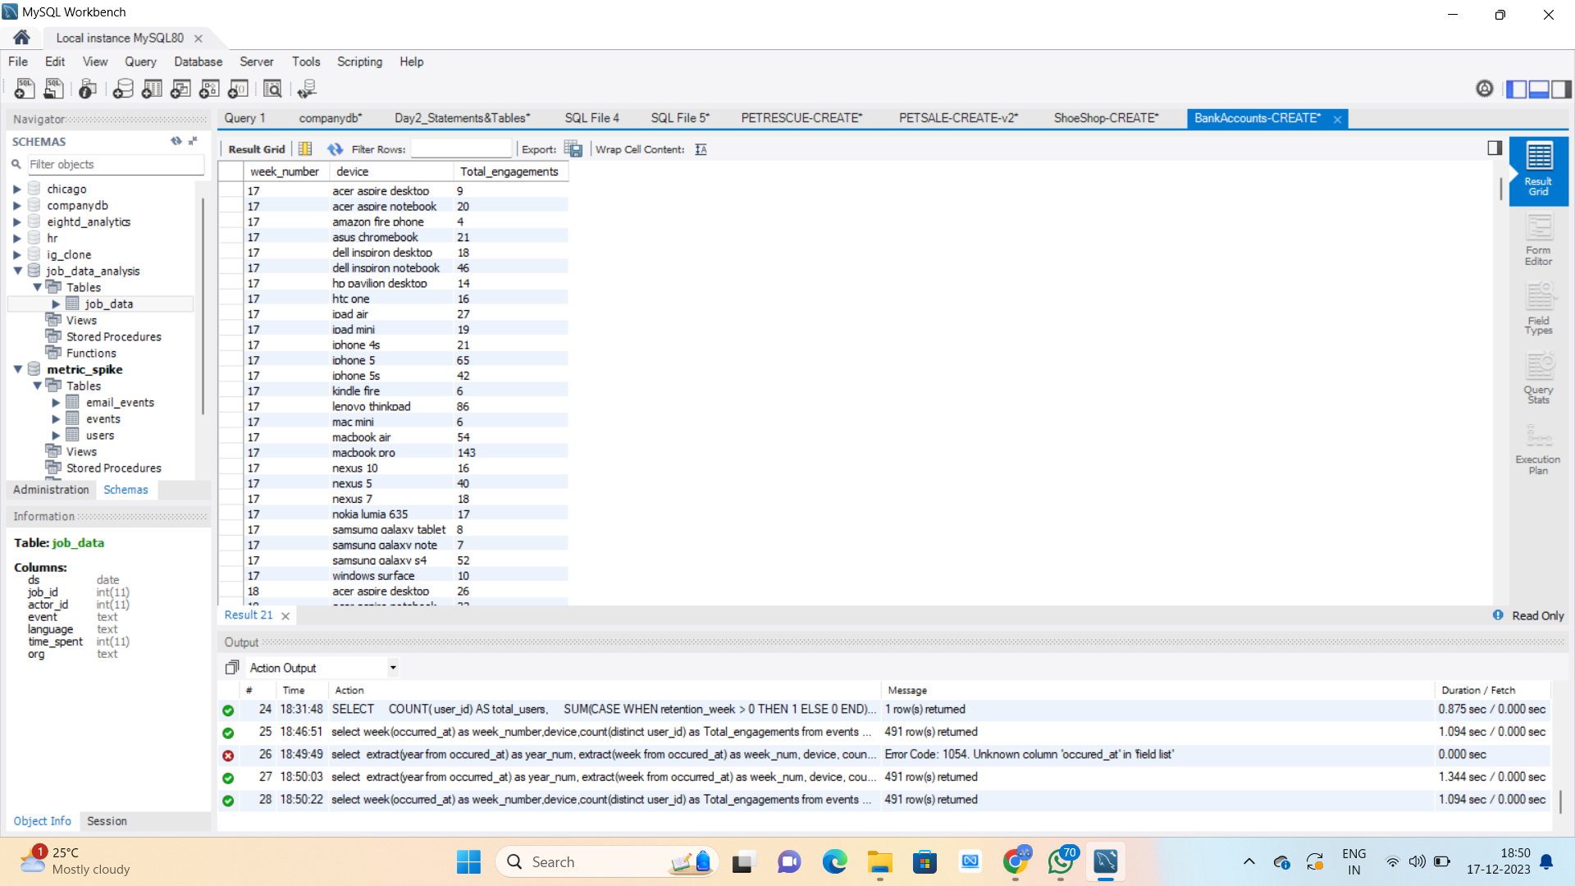
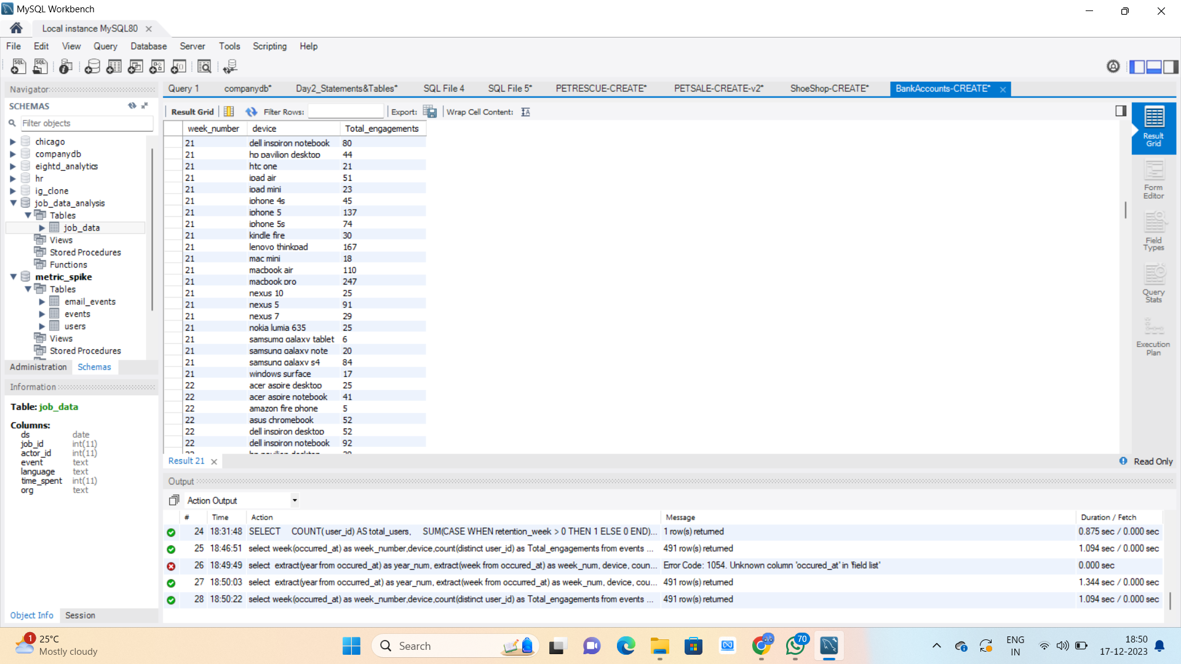
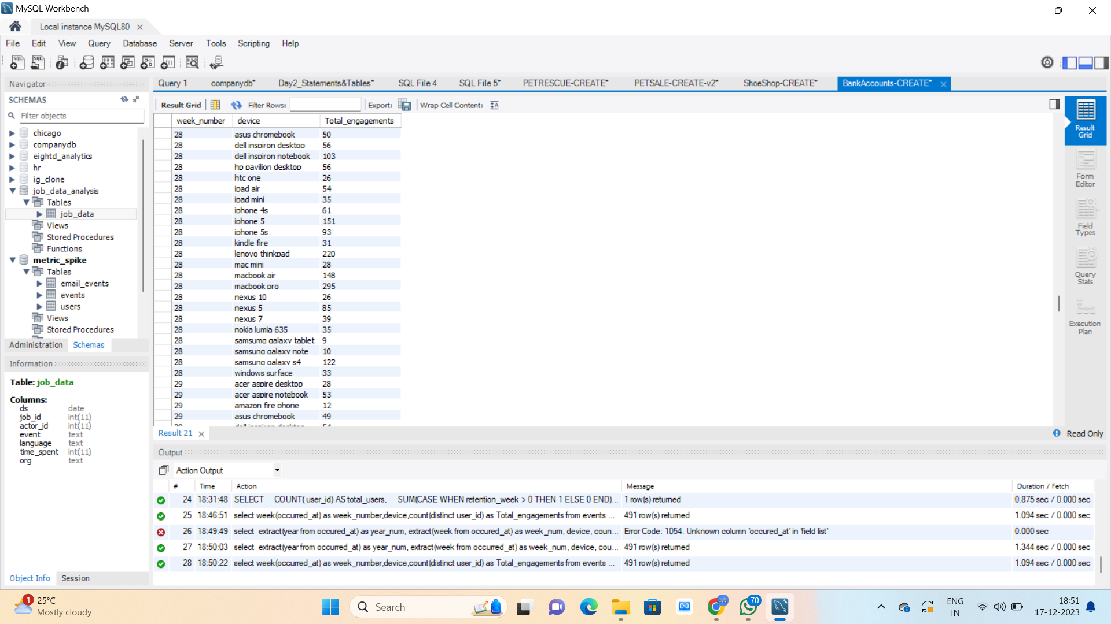
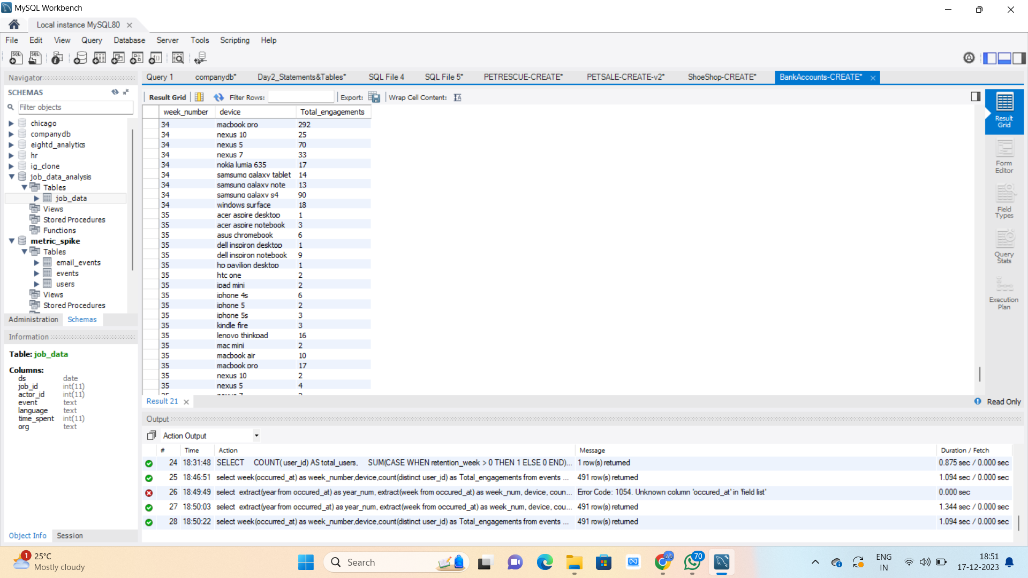
D. WEEKLY ENGAGEMENT PER DEVICE

Slide 16
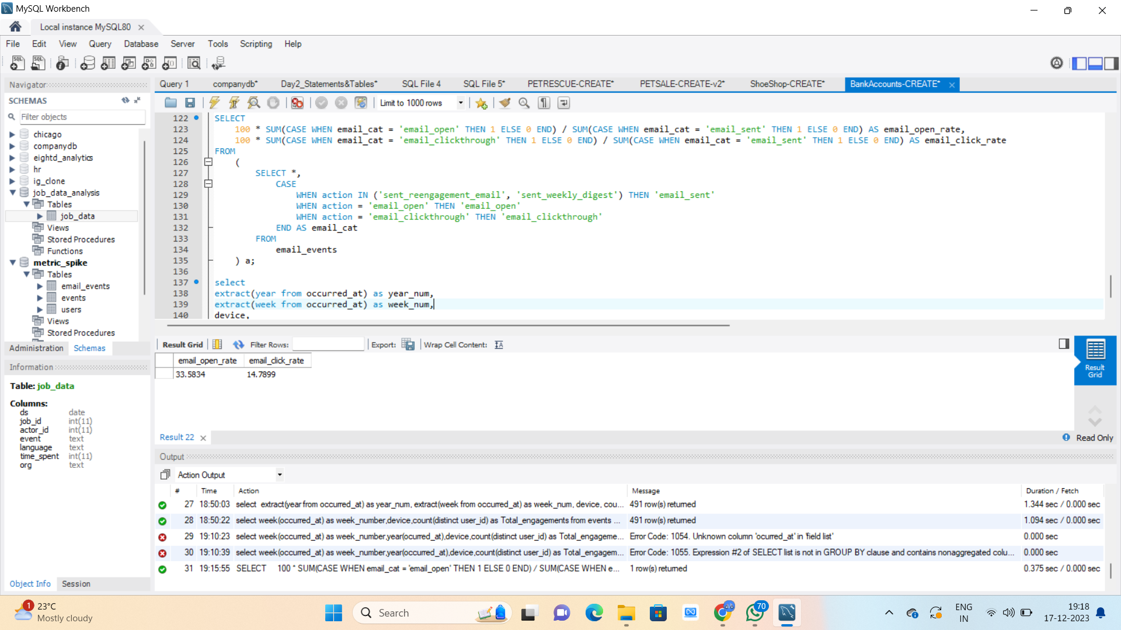
E. EMAIL ENGAGEMENT ANALYSIS
Out of the total emails sent, around 33.58% of them were opened and only 14.78% of those emails were clicked

Slide 17
E. EMAIL ENGAGEMENT ANALYSIS
Syntax
select
100 * sum(case when email_cat = 'email_open' then 1 else 0 end) / sum(case when email_cat = 'email_sent' then 1 else 0 end) as email_open_rate,
100 * sum(case when email_cat = 'email_clickthrough' then 1 else 0 end) / sum(case when email_cat = 'email_sent' then 1 else 0 end) as email_click_rate
from
(
select *,
case
when action in ('sent_reengagement_email', 'sent_weekly_digest') then 'email_sent'
when action = 'email_open' then 'email_open'
when action = 'email_clickthrough' then 'email_clickthrough'
end as email_cat
from
email_events
) a;

Slide 18

RESULTS
The project's key results included the identification of reviewed jobs and their distribution across languages, the calculation of retention rates, and the identification of retained users through an in-depth analysis that relied on predefined assumptions.
The analysis provided a comprehensive understanding of user behavior, engagement patterns, and potential areas for improvement.
Additionally, this project helped me to gain insight of various factors which are crucially important for the business to run for a long period and grow as well.

Slide 19

trainity
THANK YOU

